Slide 1

Flights Delays Project
Guy Yosef; Liran Vaiman

Slide 2
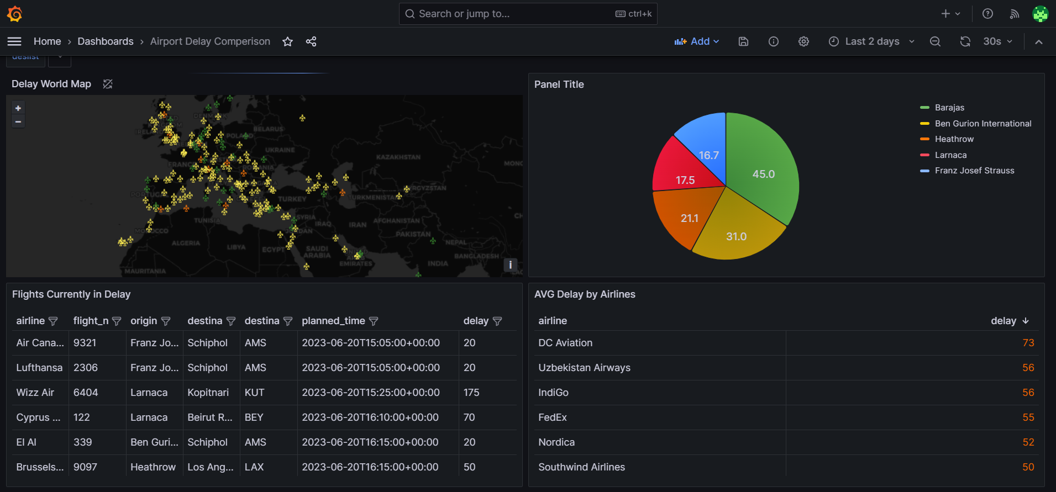
Dashboard overview

Slide 3
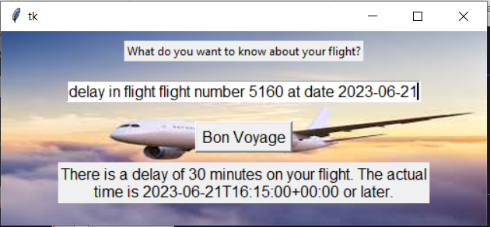
ChatBot

Slide 4
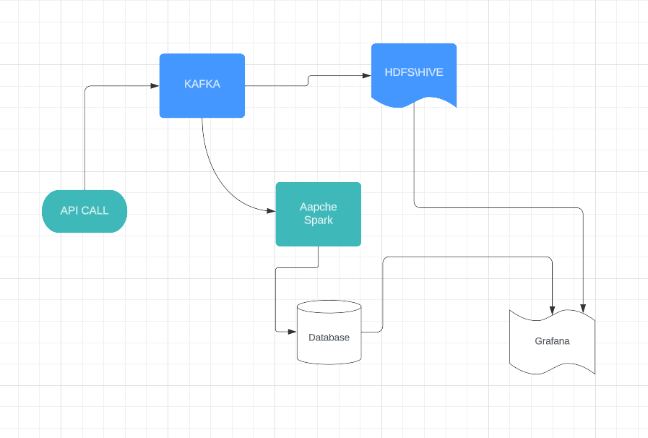
Project Data Flow

Slide 5

Project objectives:
Give real time delays in flights to clients
Give clients the ability to predict the upcoming delay based on flight’s origin, airline and destination
Give an easy-to-use graphic interface of delays data for clients using Grafana

Slide 6
We use Api calls from ‘aviationstack’ Web site using python to insert Data into Kafaka.
We read the data stored in Kafka using Python in order to insert it into Mysql
We read the data stored in Kafka using Python in order to insert it into HDFS
We’re using Grafana to read the data stored in Mysql and HDFS to present it.
We’re using CHATBOT in order to provide AI capabilities

Slide 7
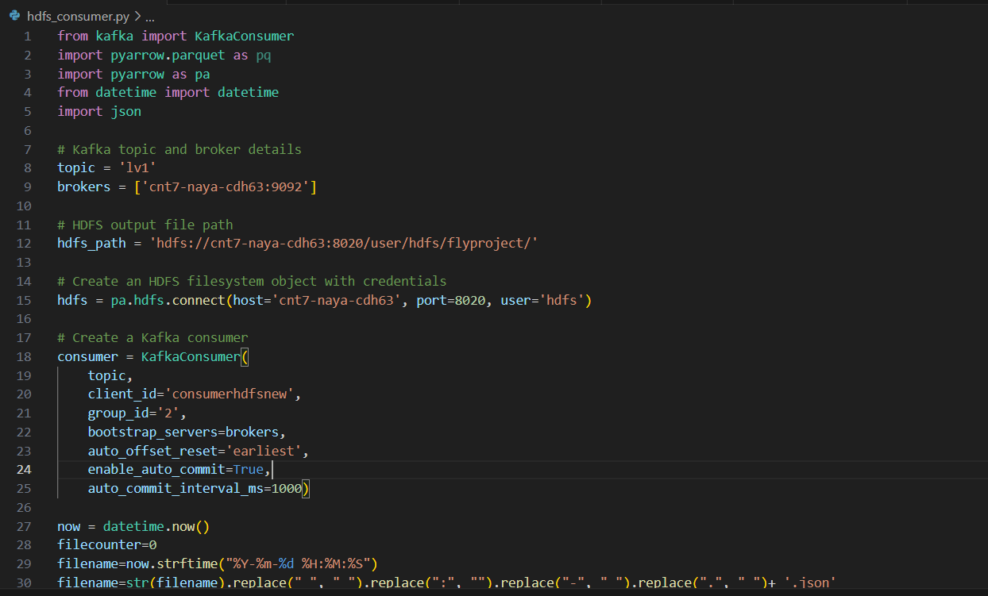
Python example code

